Slide 2
hadoop - Big Data Overview
hadoop - Big Data Solutions

Slide 3

Introduction

Slide 4

Introduction
Data produced by mankind is growing rapidly every year

Slide 5
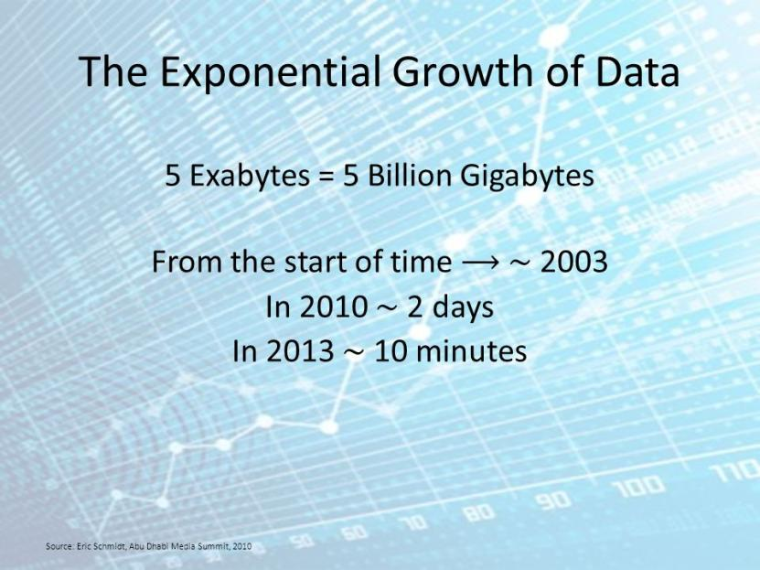
Introduction

Slide 6
What is Big Data?
Big data is a collection of large datasets that cannot be processed using traditional computing techniques.
It is not a single technique or a tool, rather it has become a complete subject, which involves various tools, techniques and frameworks.

Slide 7
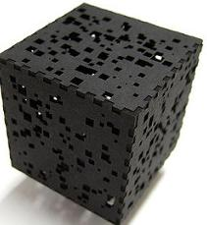
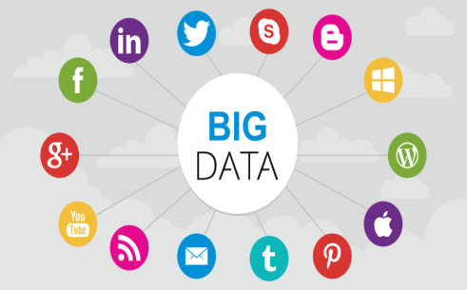
What Comes Under Big Data?
Black Box Data
Social Media Data
Big data involves the data produced by different devices and applications. Given below are some of the fields that come under the umbrella of Big Data.

Slide 8

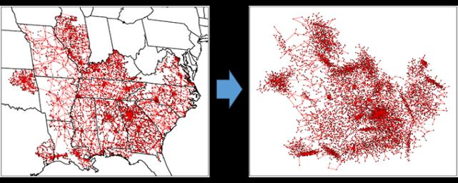
What Comes Under Big Data?
Stock Exchange Data
Power Grid Data

Slide 9
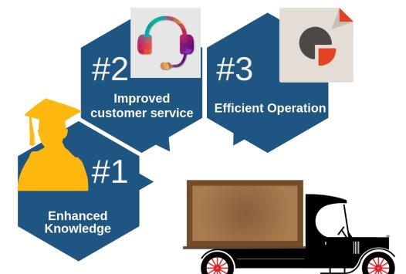
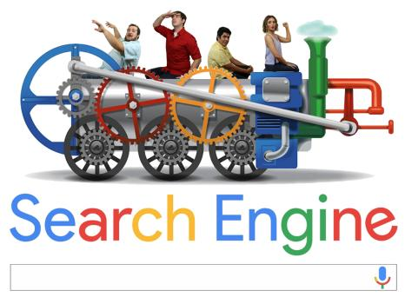
What Comes Under Big Data?
Search Engine
Transport Data

Slide 10
What Comes Under Big Data?
Thus, Big Data includes huge volume, high velocity, and extensible variety of data..
  Structured data − Relational data.
  Semi Structured data − XML data.
  Unstructured data − Word, PDF, Text, Media Logs.

Slide 11
What Comes Under Big Data?
  Structured data
  Semi Structured data
  Unstructured data

Slide 12
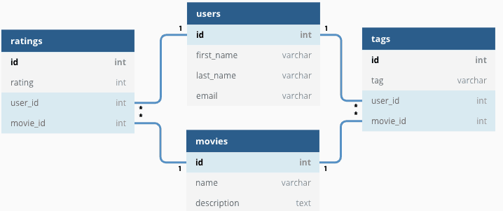
The data in it will be of three types
Structured data
Relational data

Slide 13
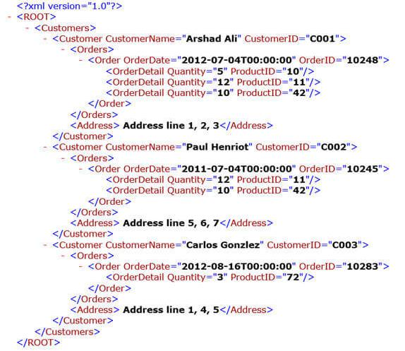
The data in it will be of three types
  Semi Structured data
XML data

Slide 14



The data in it will be of three types
  Unstructured data
Word
PDF
Text

Slide 15
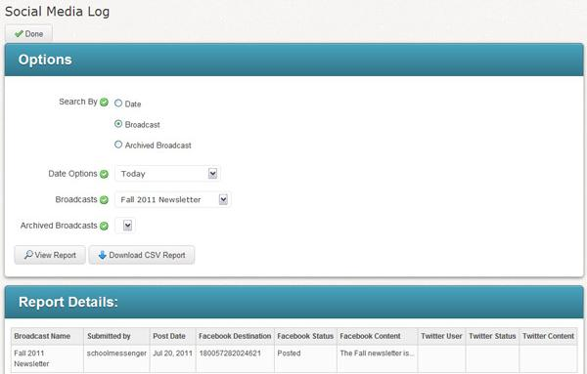
The data in it will be of three types
  Unstructured data
Social Media Log

Slide 16




Benefits of Big Data

Slide 17
Big Data Technologies
Accurate analysis
Greater operational efficiencies,
cost reductions,
and reduced risks for the business.

Slide 18

Big Data Technologies
Structure
Unstructured

Slide 19



Big Data Technologies

Slide 20
Big Data Technologies
Two classes of technology
Analytical Big Data
Operational Big Data

Slide 21


Operational Big Data

Slide 22
Operational Big Data
Manage
Cheaper
Faster

Slide 23
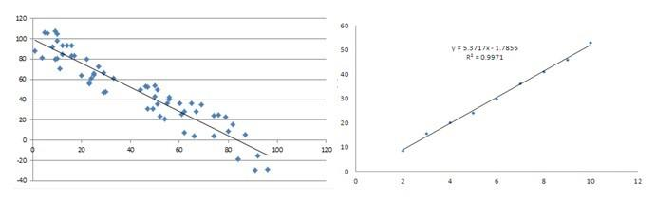
Operational Big Data
Patterns and Trends

Slide 24
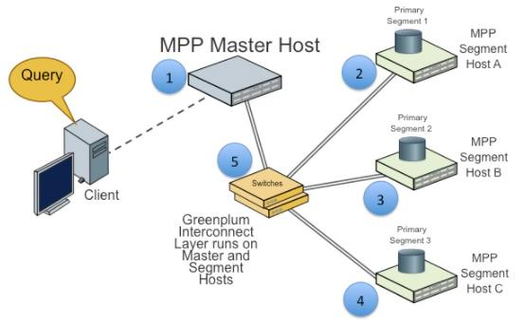
Analytical Big Data
Massively Parallel Processing

Slide 25

Analytical Big Data
MapReduce provides a new method of analyzing data that is complementary to the capabilities provided by SQL, and a system based on MapReduce that can be scaled up from single servers to thousands of high- and low-end machines.

Slide 26
Operational vs. Analytical Systems
 | Operational | Analytical
Latency | 1 ms - 100 ms | 1 min - 100 min
Concurrency | 1000 - 100,000 | 1 - 10
Access Pattern | Writes and Reads | Reads
Queries | Selective | Unselective
Data Scope | Operational | Retrospective
End User | Customer | Data Scientist
Technology | NoSQL | MapReduce, MPP Database

Slide 27

BIG DATA SOLUTIONS

Slide 28
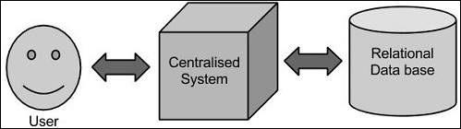
Traditional Approach
Traditional Approach

Slide 29
Traditional Approach
Limitation
  Process less voluminous data that can be accommodated by standard database servers
  Hectic task to process such data through a single database bottleneck.

Slide 30
Google’s Solution
Google solved this problem using an algorithm called MapReduce.
This algorithm divides the task into small parts and assigns them to many computers, and collects the results from them which when integrated, form the result dataset.

Slide 31
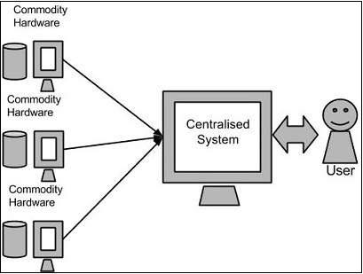
Google’s Solution

Slide 32
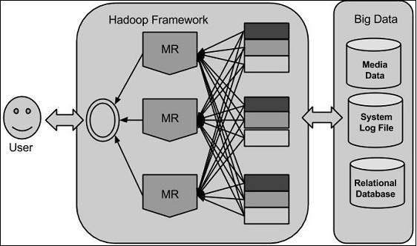
Google’s Solution

